Slide 1
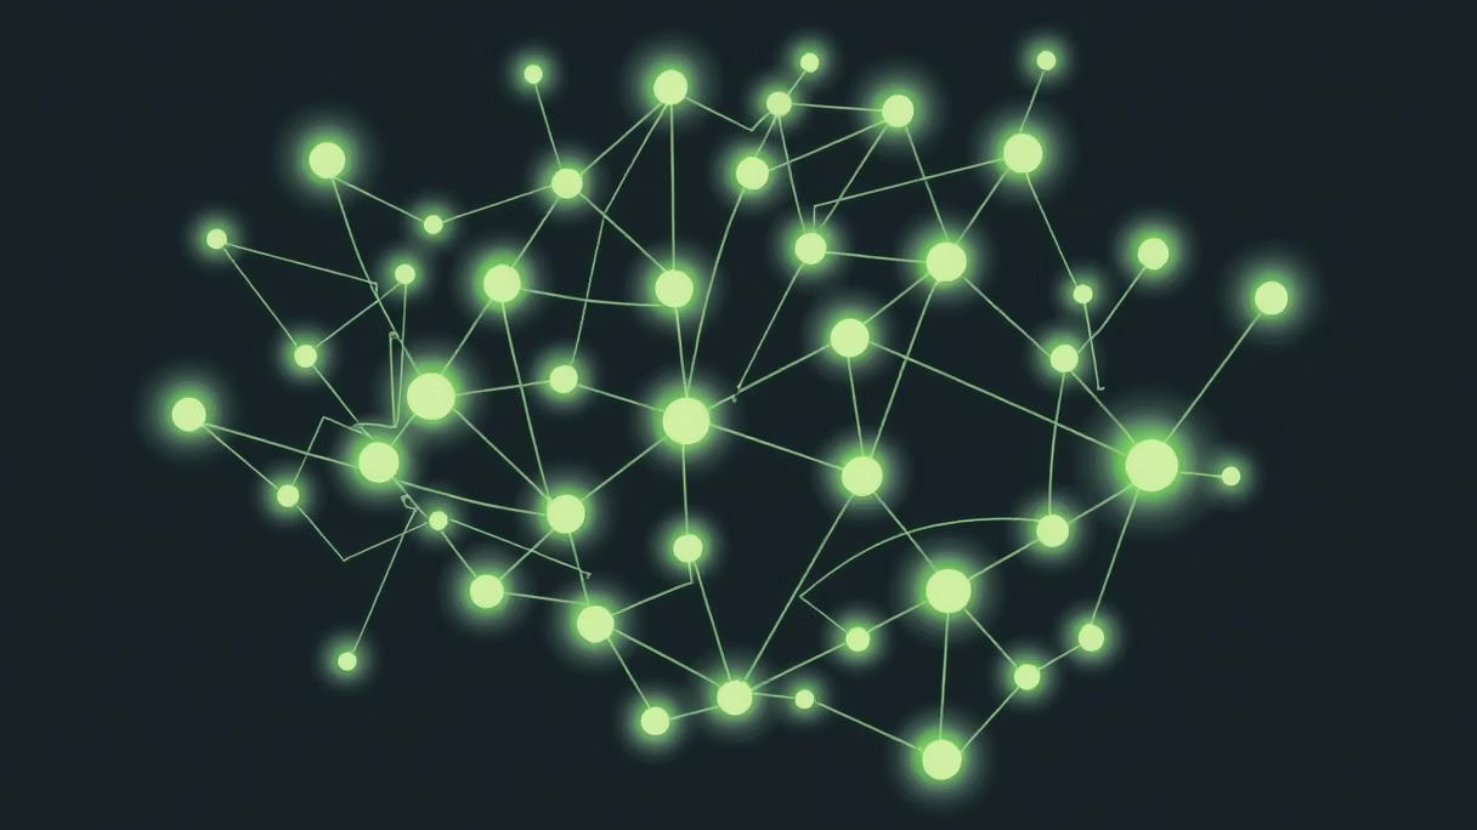
Artificial Neural Networks
Unlocking the Power of Machine Intelligence
Exploring the architecture, mechanisms, and applications of ANNs

Slide 2
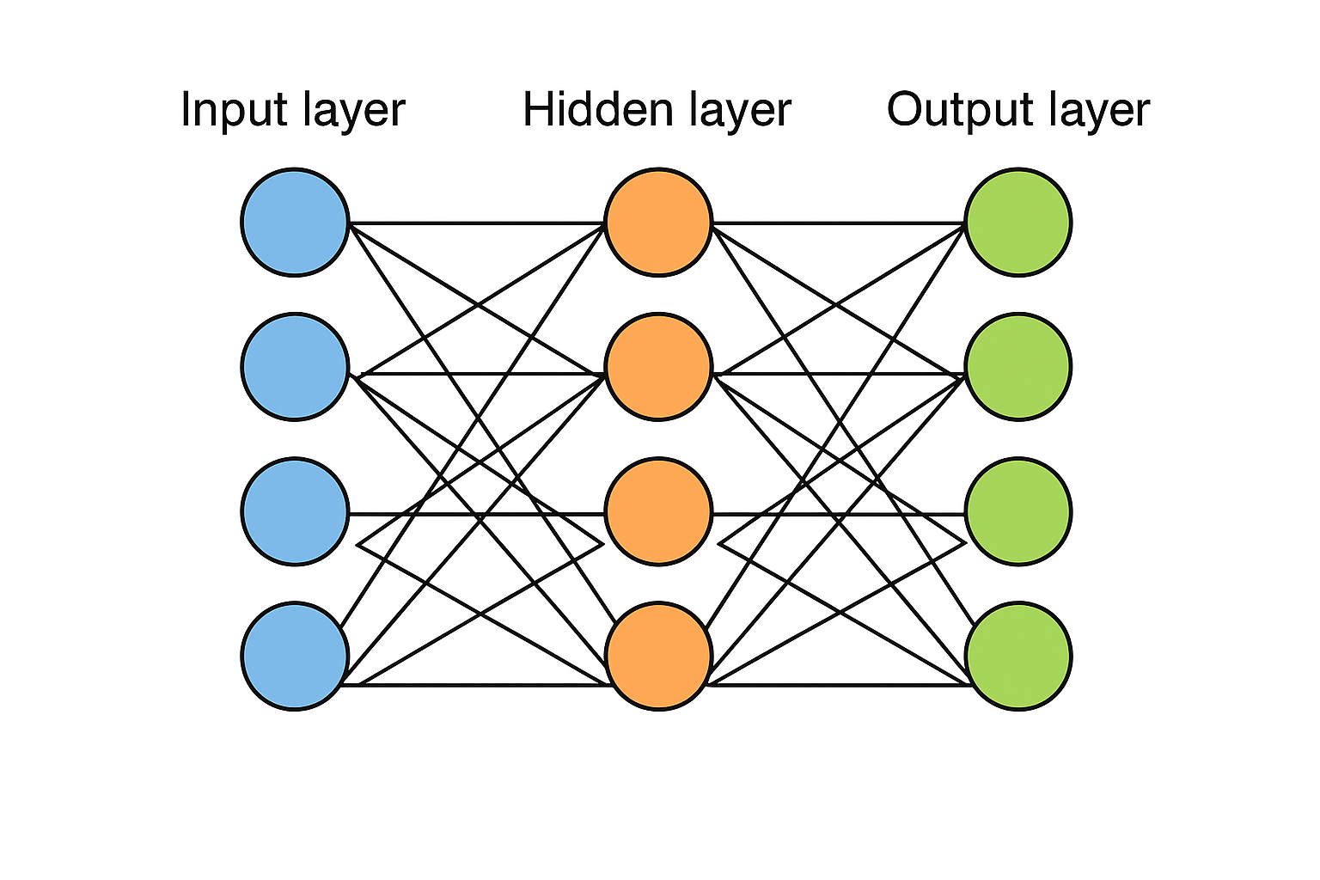
What is an Artificial Neural Network?
Artificial Neural Networks (ANNs) are computational models inspired by the human brain's structure and function. They are designed to recognize patterns and learn from data.
At their core, ANNs consist of interconnected nodes (neurons) organized in layers, processing information through these connections.
Data → Machine Learning → Feature Engineering → Model Training → Predictions
↓ (Automated in Deep Learning)
Data → Deep Learning → Neural Networks (Hidden Layers) → Predictions
🔹 Machine Learning (ML)
Learns from data using algorithms (e.g., Decision Trees, SVM, Linear Regression).
Needs manual feature engineering.
Works well with small to medium datasets.
Shallow models (few layers).
🔹 Deep Learning (DL)
Subset of ML based on Artificial Neural Networks.
Automatically extracts features from raw data.
Requires large datasets + high computing power (GPUs).
Multiple hidden layers (deep models) → better accuracy in complex tasks.

Slide 3
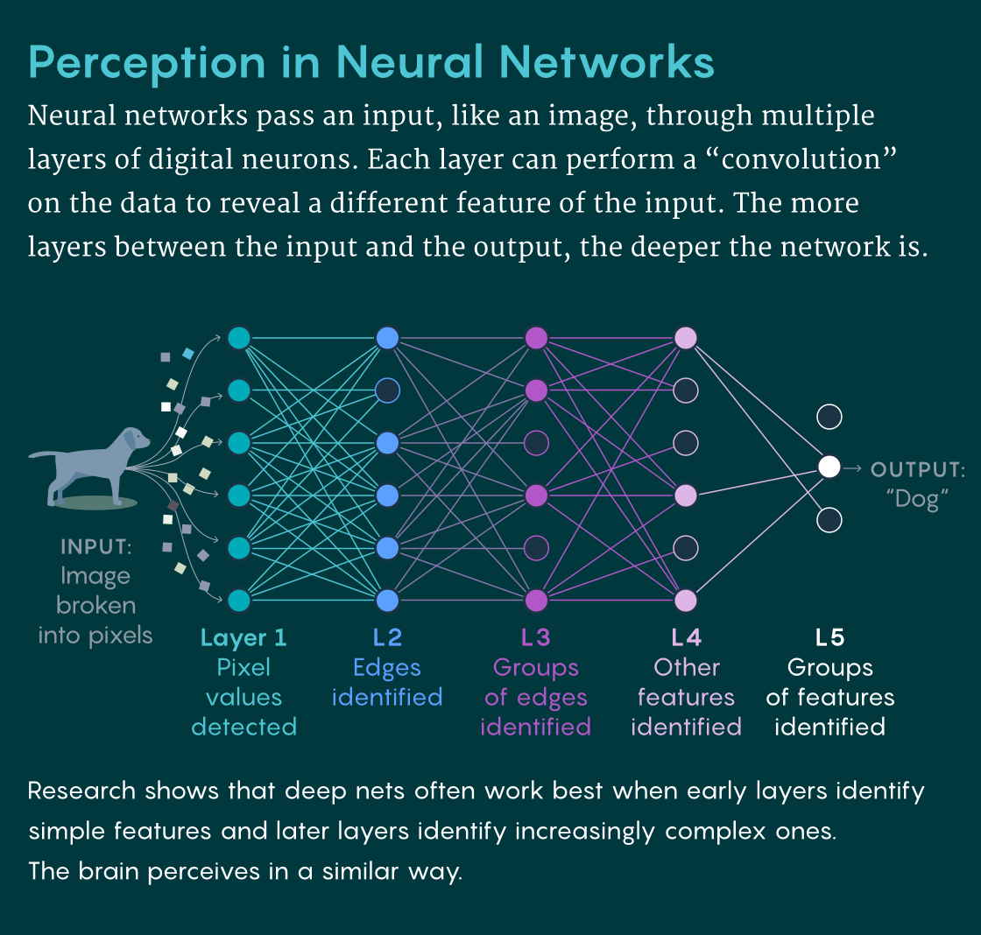
ANN Architecture: Layers of Intelligence
ANNs are structured into distinct layers, each playing a crucial role in processing information.
Input Layer
Hidden Layers
Output Layer
Receives raw data (e.g., pixel values, sensor readings). Each node represents an input feature.
Perform complex computations and feature extraction. There can be multiple hidden layers, increasing model complexity.
Provides the final result of the network (e.g., classification, prediction). The number of nodes depends on the task.

Slide 4
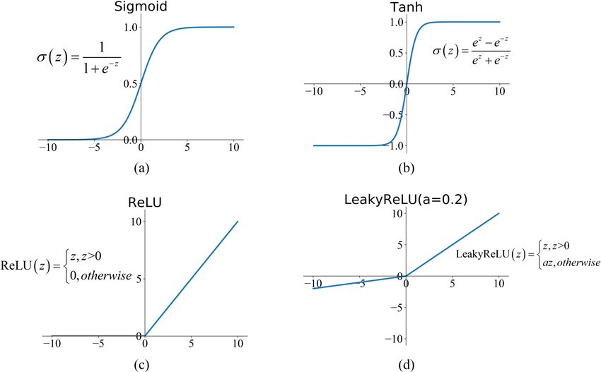
Key Components of a Neural Network
🔹 Weights (W)
Control the importance of each input.
Larger weight → stronger influence on output.
🔹 Bias (b)
Shifts the output curve up or down.
Makes the model more flexible.
🔹 Activation Function (σ)
Decides if a neuron should activate.
Adds non-linearity so the model can learn complex patterns.
Z=W.X + b
Output=σ(z)…
σ(W.X + b)

Slide 5
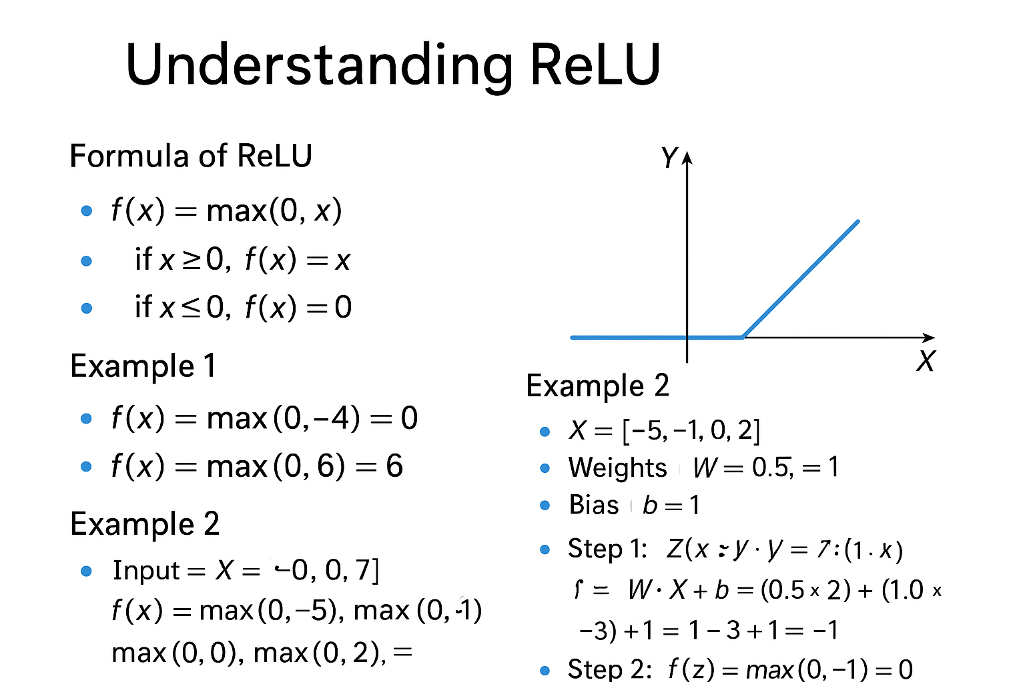

Slide 6
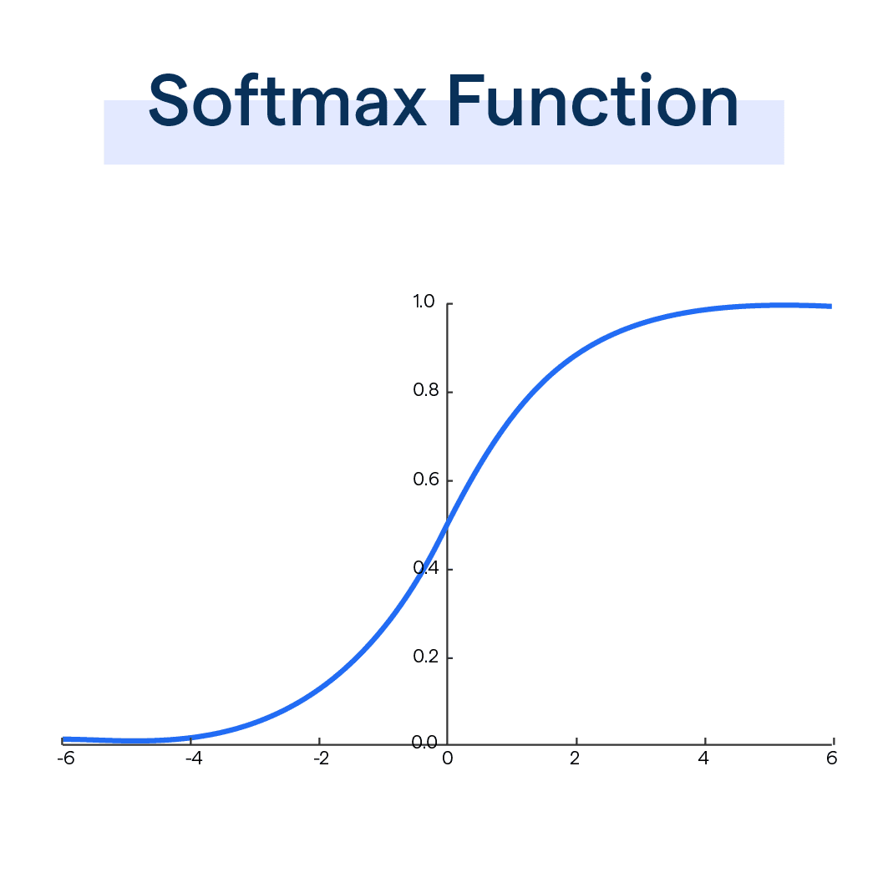
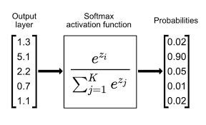
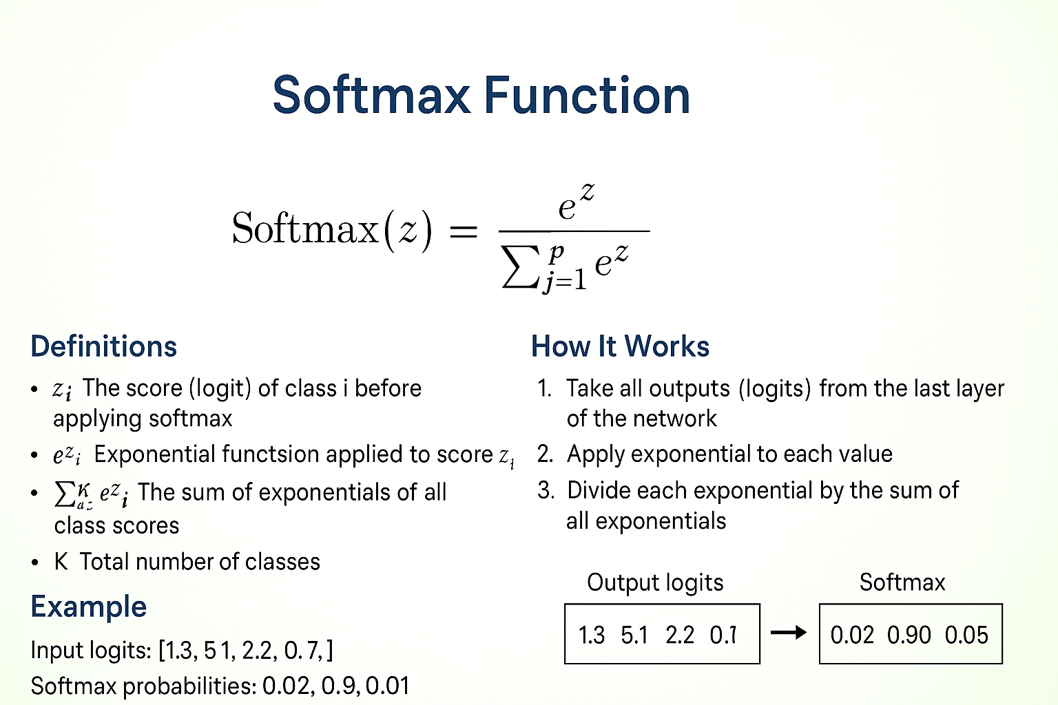

Slide 7
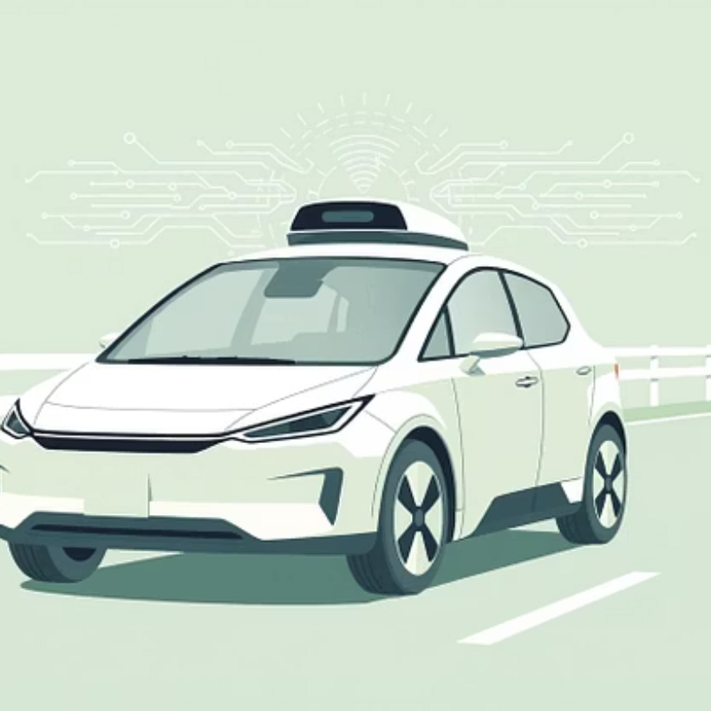
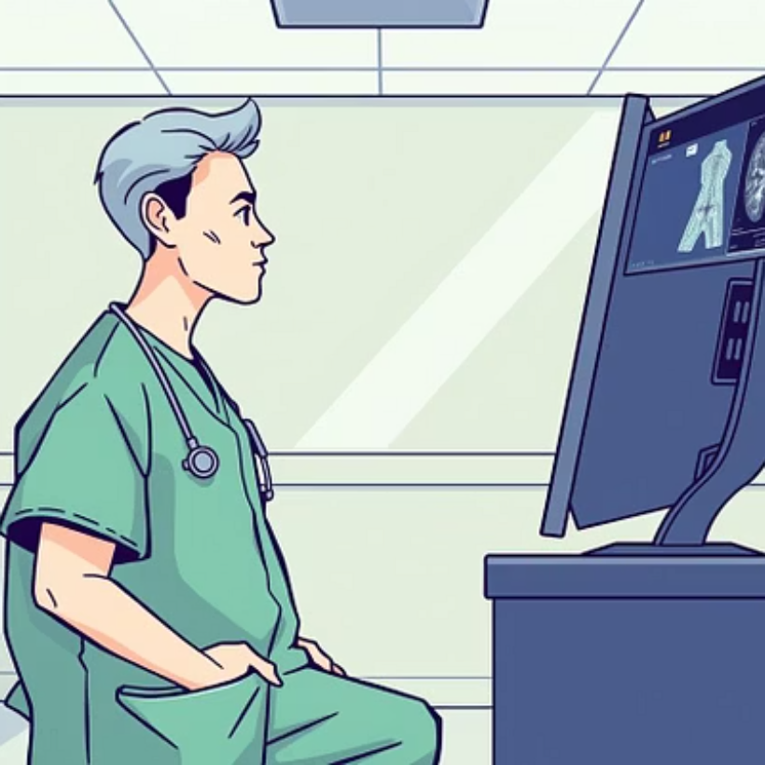

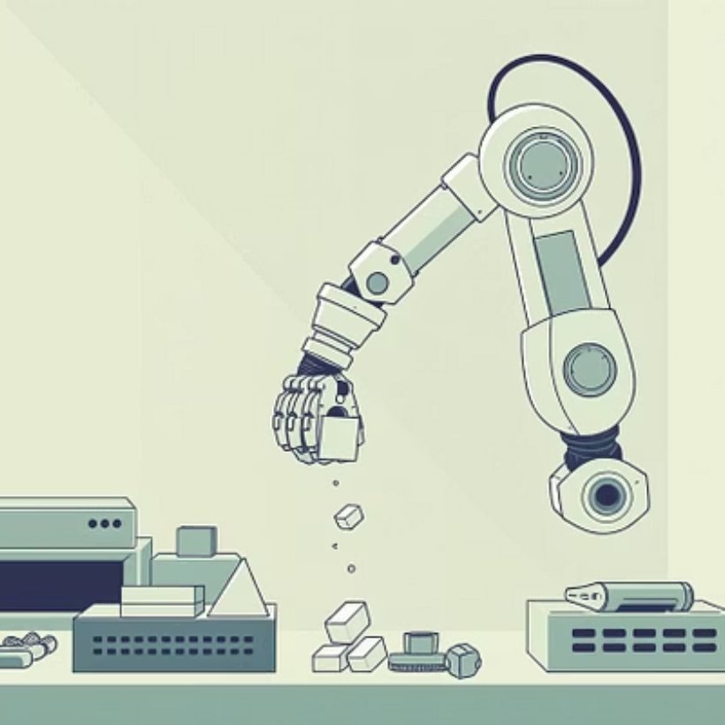
Real-World Applications of ANNs
Neural networks power many transformative technologies we use daily.
Image Recognition: Facial recognition, object detection, medical imaging analysis.
Natural Language Processing (NLP): Language translation, spam detection, sentiment analysis.
Self-Driving Cars: Perception, navigation, decision-making.
Healthcare: Disease diagnosis, drug discovery, personalized medicine.

Slide 8
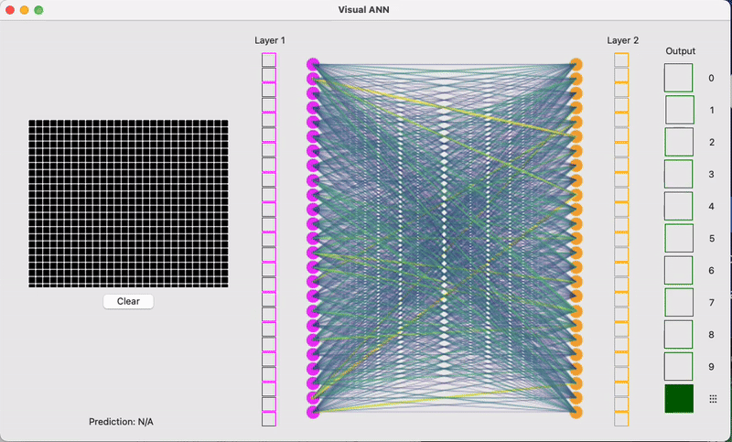
Key Takeaways & The Future of ANNs
"Artificial neural networks are not just a technology; they are a paradigm shift in how we approach problem-solving and intelligence."
Key Takeaways:
ANNs are inspired by the brain, capable of learning complex patterns.
Composed of layers (input, hidden, output) processing data through forward propagation and backpropagation.
Underpin a vast array of modern AI applications from vision to language.
The Future:
Continuous advancements in efficiency, scale, and interpretability.
Integration into nearly every aspect of daily life and industry.
Pushing boundaries towards more general and human-like AI.

Slide 9
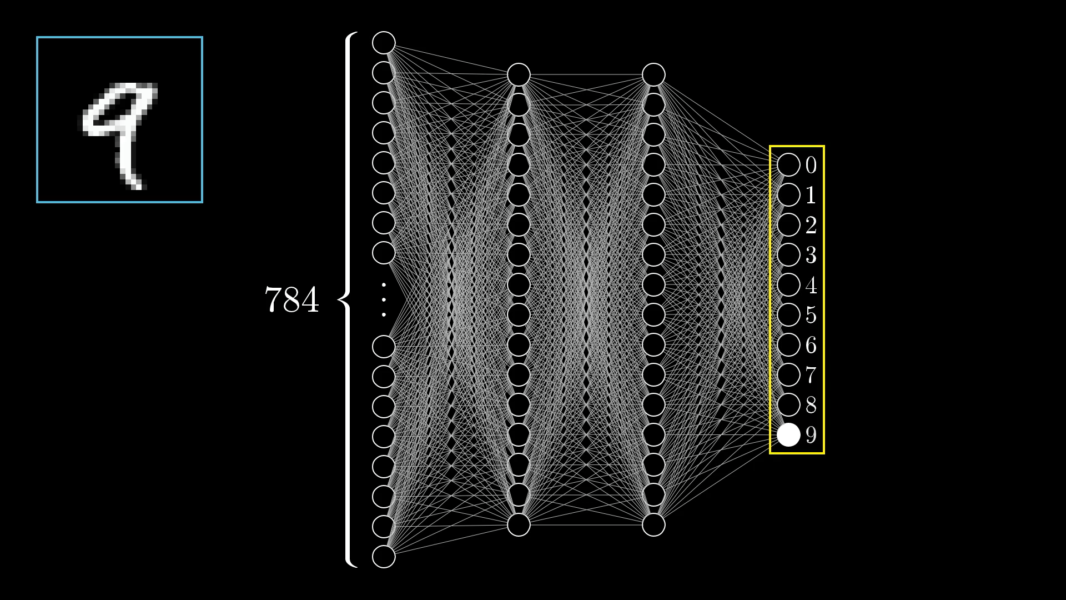
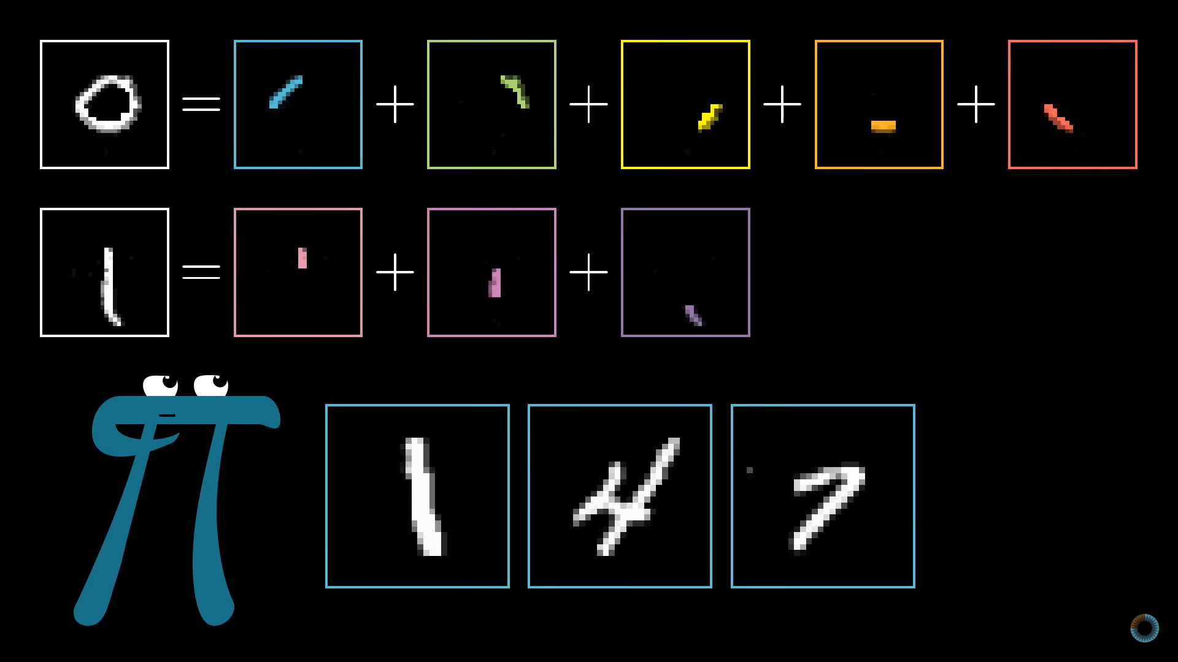
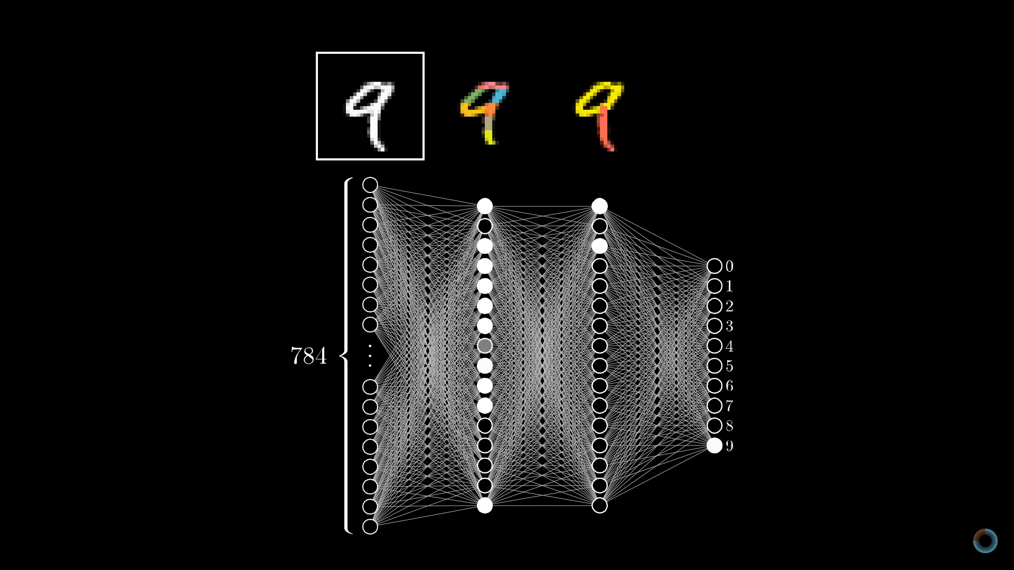
Key Takeaways & The Future of ANNs
"Artificial neural networks are not just a technology; they are a paradigm shift in how we approach problem-solving and intelligence."
Key Takeaways:
ANNs are inspired by the brain, capable of learning complex patterns.
Composed of layers (input, hidden, output) processing data through forward propagation and backpropagation.
Underpin a vast array of modern AI applications from vision to language.
The Future:
Continuous advancements in efficiency, scale, and interpretability.
Integration into nearly every aspect of daily life and industry.
Pushing boundaries towards more general and human-like AI.

Slide 10
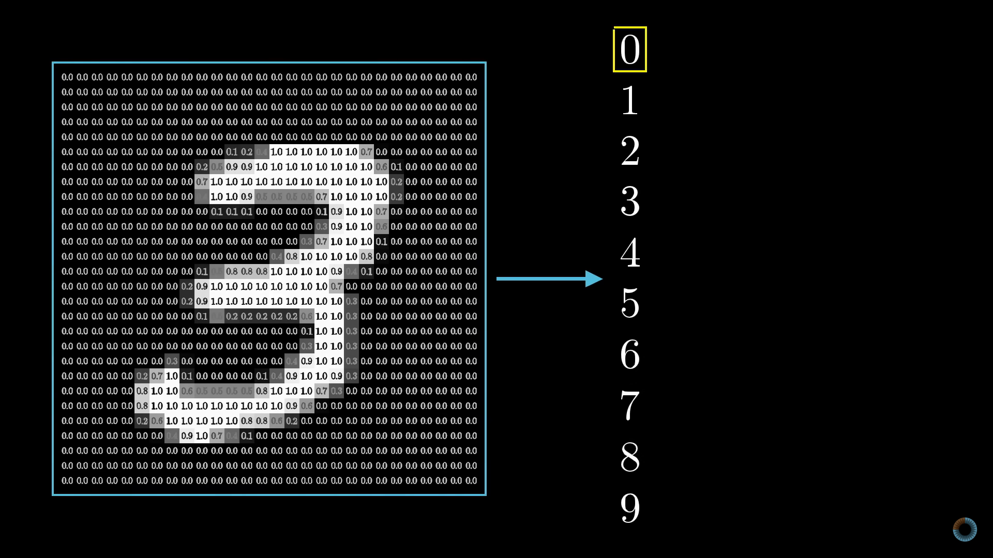
Key Takeaways & The Future of ANNs
"Artificial neural networks are not just a technology; they are a paradigm shift in how we approach problem-solving and intelligence."
Key Takeaways:
ANNs are inspired by the brain, capable of learning complex patterns.
Composed of layers (input, hidden, output) processing data through forward propagation and backpropagation.
Underpin a vast array of modern AI applications from vision to language.
The Future:
Continuous advancements in efficiency, scale, and interpretability.
Integration into nearly every aspect of daily life and industry.
Pushing boundaries towards more general and human-like AI.

Slide 11
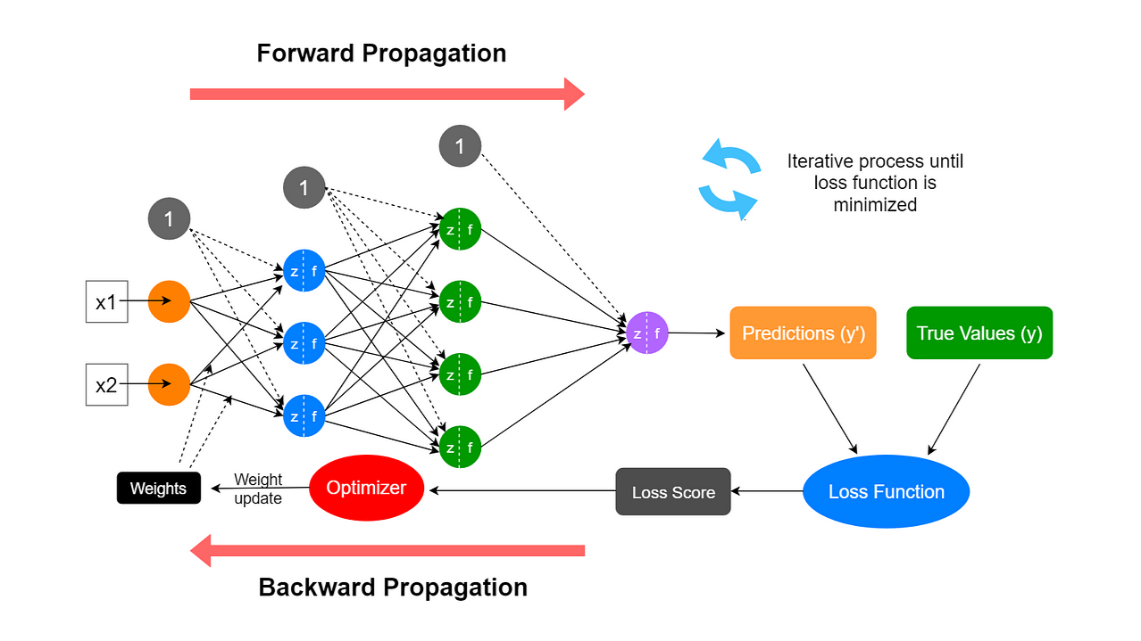
How ANNs Learn: The Core Mechanisms
ANNs learn by adjusting internal weights and biases through iterative processes.
Forward Propagation
Activation Functions
Backpropagation
Inputs pass through the network layers, activating neurons and producing an output.
Introduce non-linearity, allowing the network to learn complex patterns (e.g., ReLU, Sigmoid, Softmax).
Calculates the error between predicted and actual outputs, then adjusts weights backward through the network to minimize this error.

